Slide 1
Final Project – Group 6
Forecasting using ML/fbProphet
Mino Peric, Erika Hoshino, Yao Ding, Srivasthan Krishna

Slide 2
Contents
Overview
Applications
Objectives
Demonstration
Conclusion

Slide 3



Applications
Excel fbProphet Flask Jupyter Notebook Machine Learning Matplotlib Pandas Python

Slide 4
Overview
“How environmentally friendly and sustainable are electric vehicles in Australia if we continue to generate and consume electricity generated by fossil fuels?”
To investigate this question, the project was split into three parts;
Past
Investigating and analysing trends based on historical/current data on;
Electric vehicle uptake (nationally and by state)
Electricity generation and consumption by fuel type (nationally and by state)
Global crude oil prices
Present
Determining whether there are identifiable correlations between;
The number of electric vehicles in Australia
Electricity generation and consumption
Global crude oil prices
Future
Forecasting future performances and trends of;
Electric vehicle uptake in Australia
Electricity generation and consumption
Global crude oil prices

Slide 5
Objectives
01
Collate datasets relating to Electric Vehicle uptake, Crude Oil/Resource Price, Trends in electricity generation/consumption in Australia.
02
Build a machine-learning model which predicts future values/prices.
03
Develop a user-friendly/interactive application that returns model-forecasted values/prices based on year.

Slide 6
Datasets
Electric Vehicles https://www.budgetdirect.com.au/car-insurance/research/electric-car-sales-australia.html
Crude Oil https://datasource.kapsarc.org/explore/dataset/spot-prices-for-crude-oil-and-petroleum-products/information/
Lithium https://www.statista.com/statistics/606350/battery-grade-lithium-carbonate-price/
Global Temperature https://www.ncdc.noaa.gov/cag/global/time-series

Slide 7
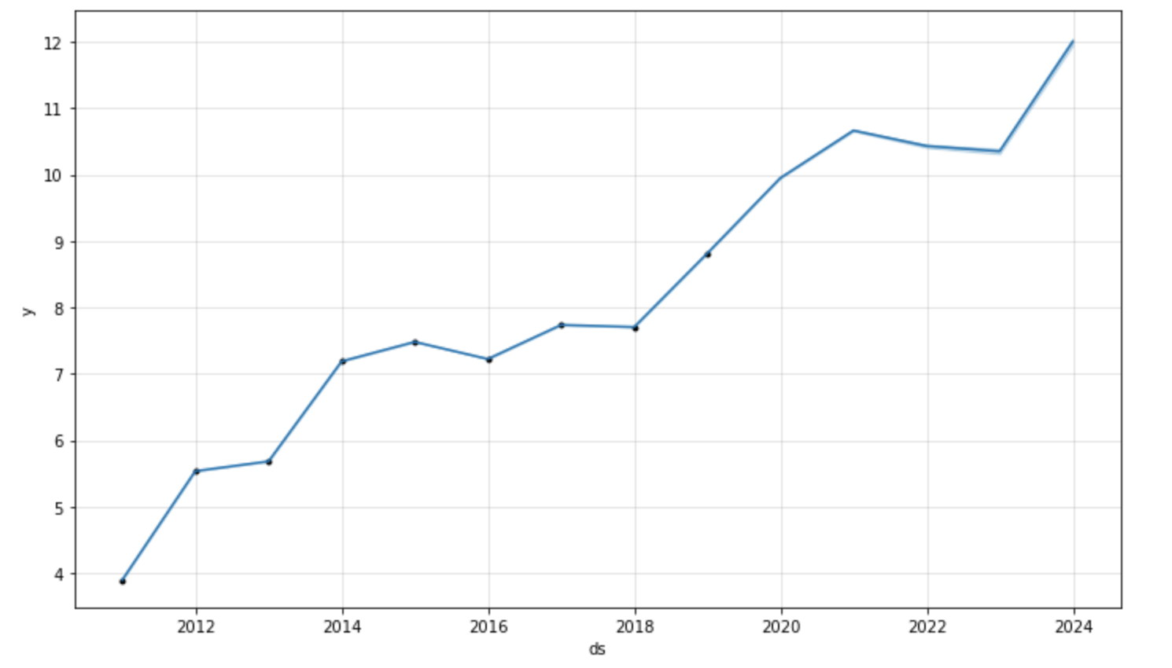
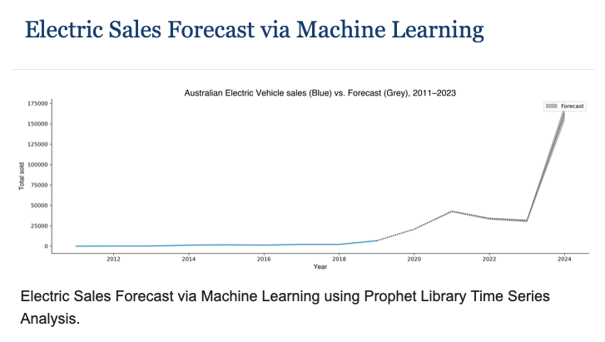
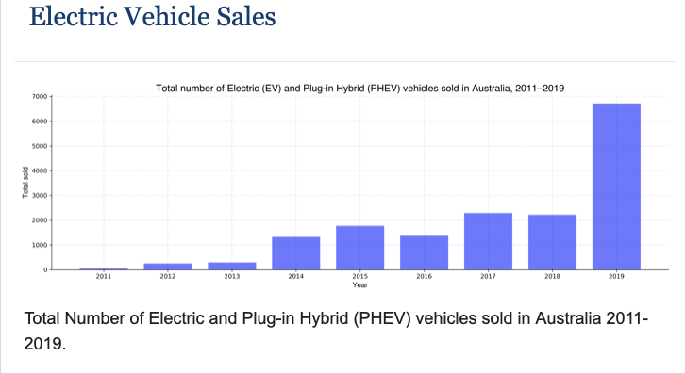
Electric Vehicles

Slide 8
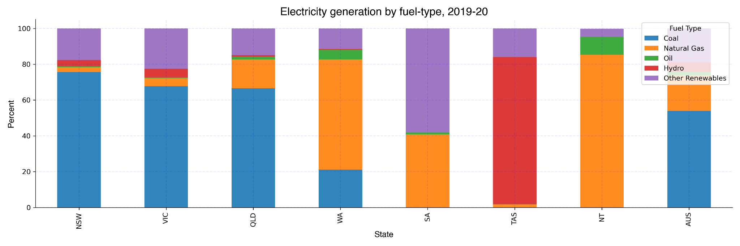
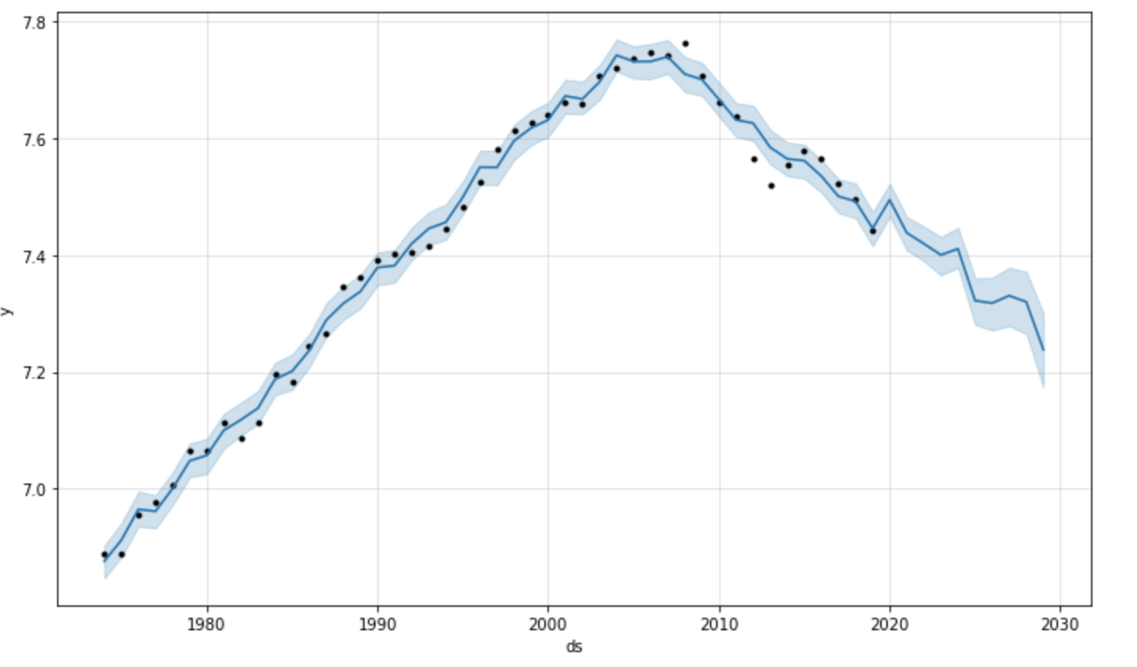
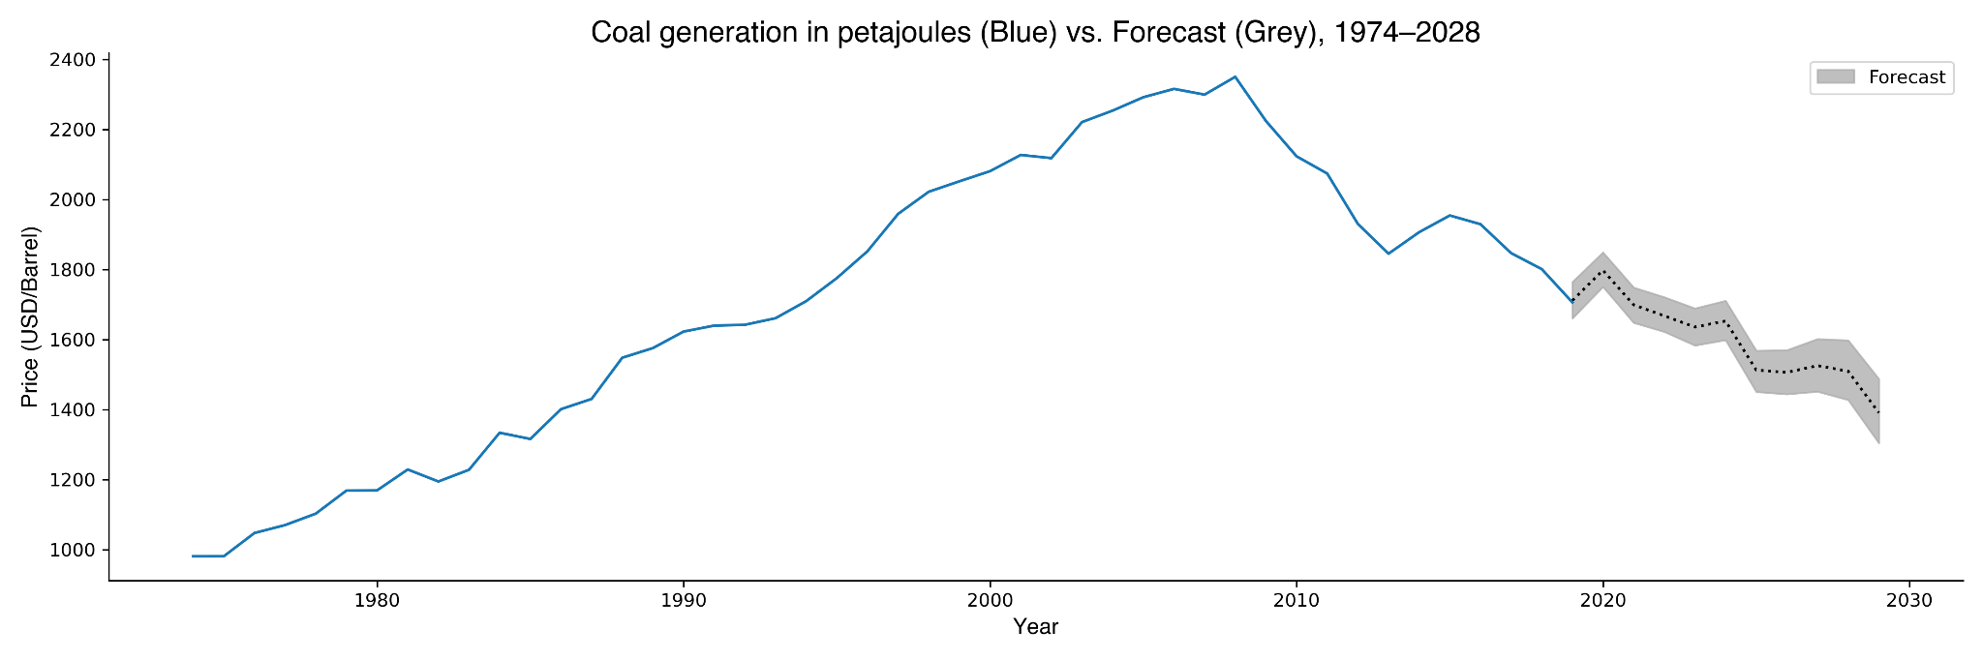
Electricity Generation (Coal)

Slide 9
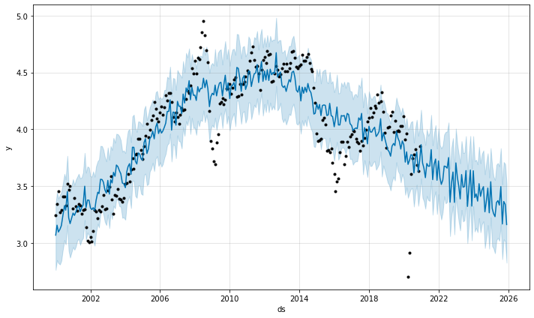
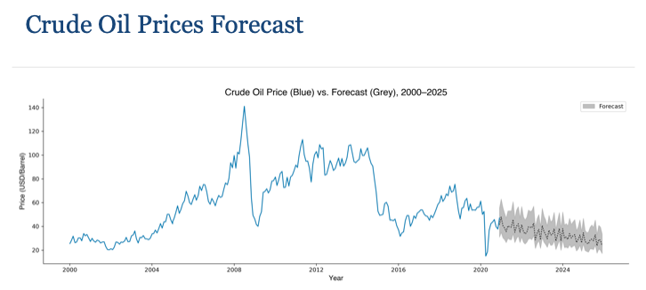
Crude Oil

Slide 10
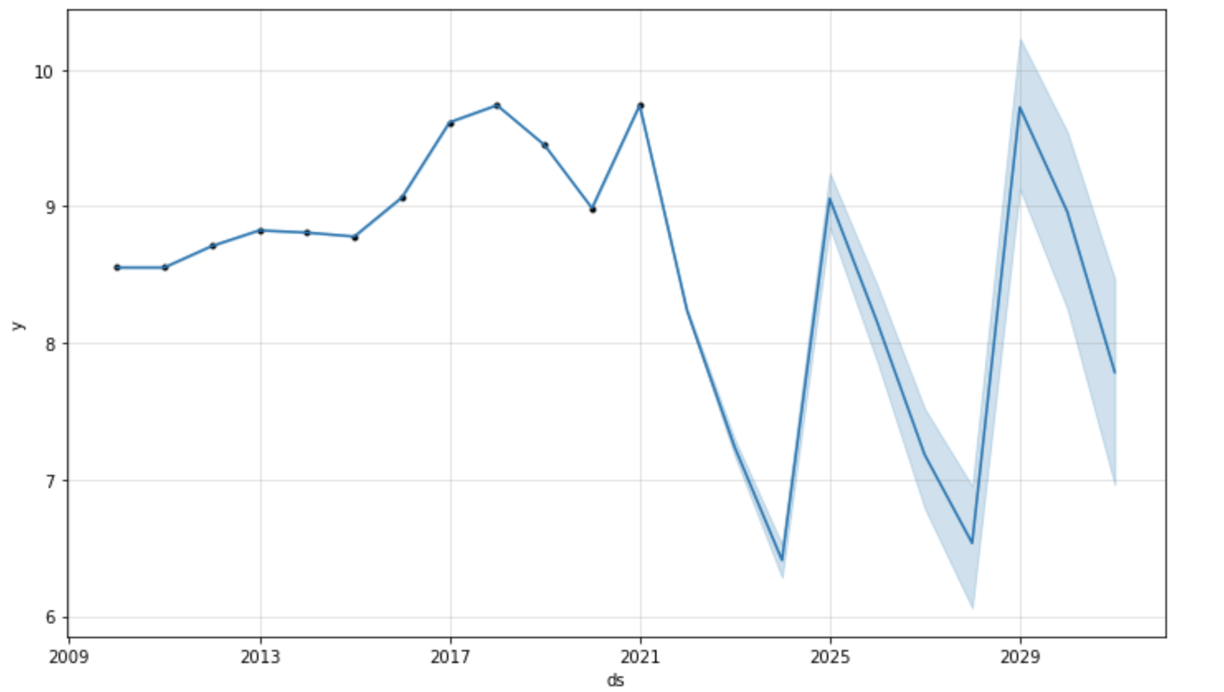
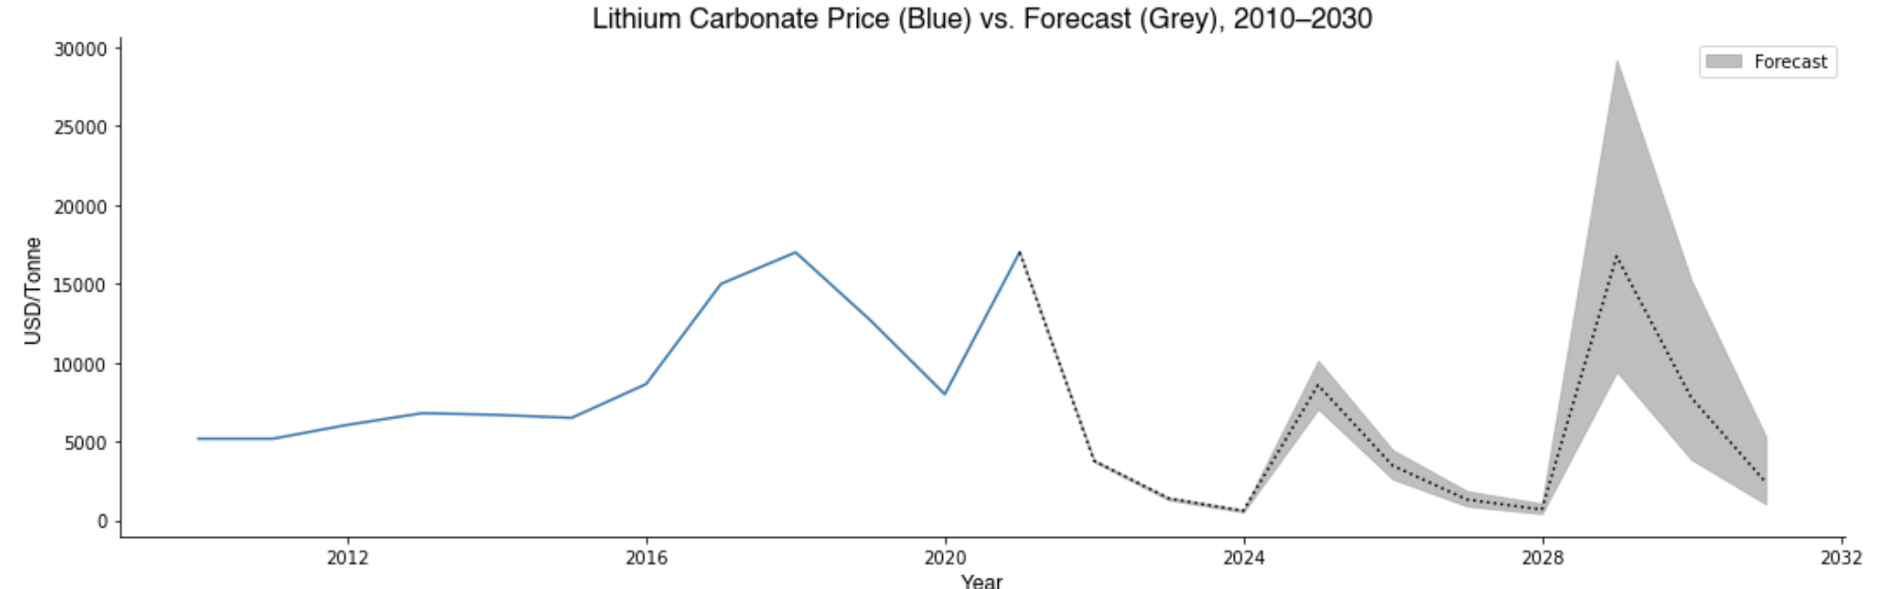
Lithium

Slide 11
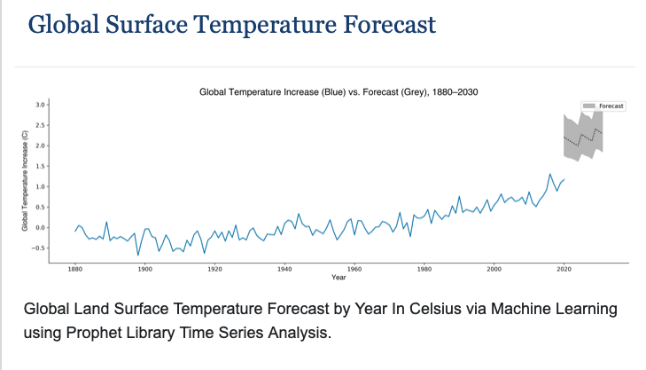
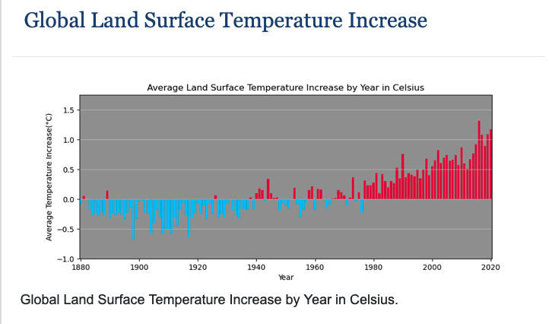
Global Temperature

Slide 12
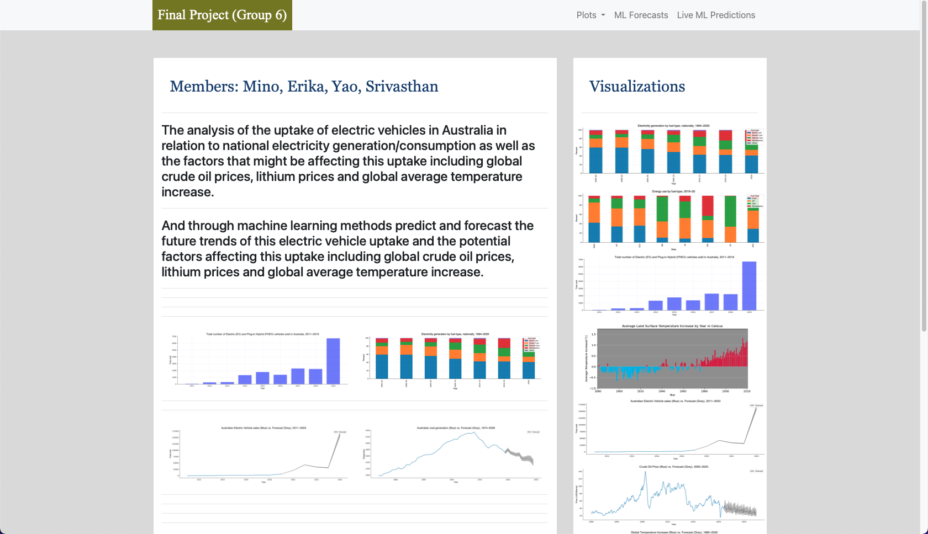
Interactive Flask App

Slide 13
Interactive Flask App – Demonstration

Slide 14
Questions

